Slide 1
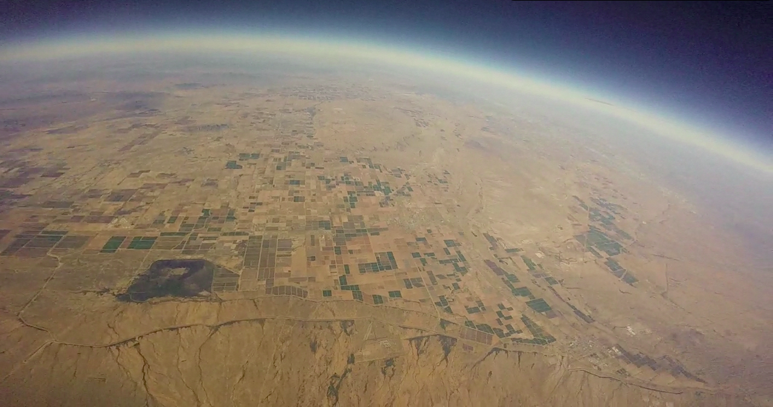
Atmospheric Particle Collection Project:
Fabrication
Pima Community College - West Campus
Francisco Montoya
William Chan
Kyle Anderson
Kyle Gordon
Jeff Johnson

Slide 2
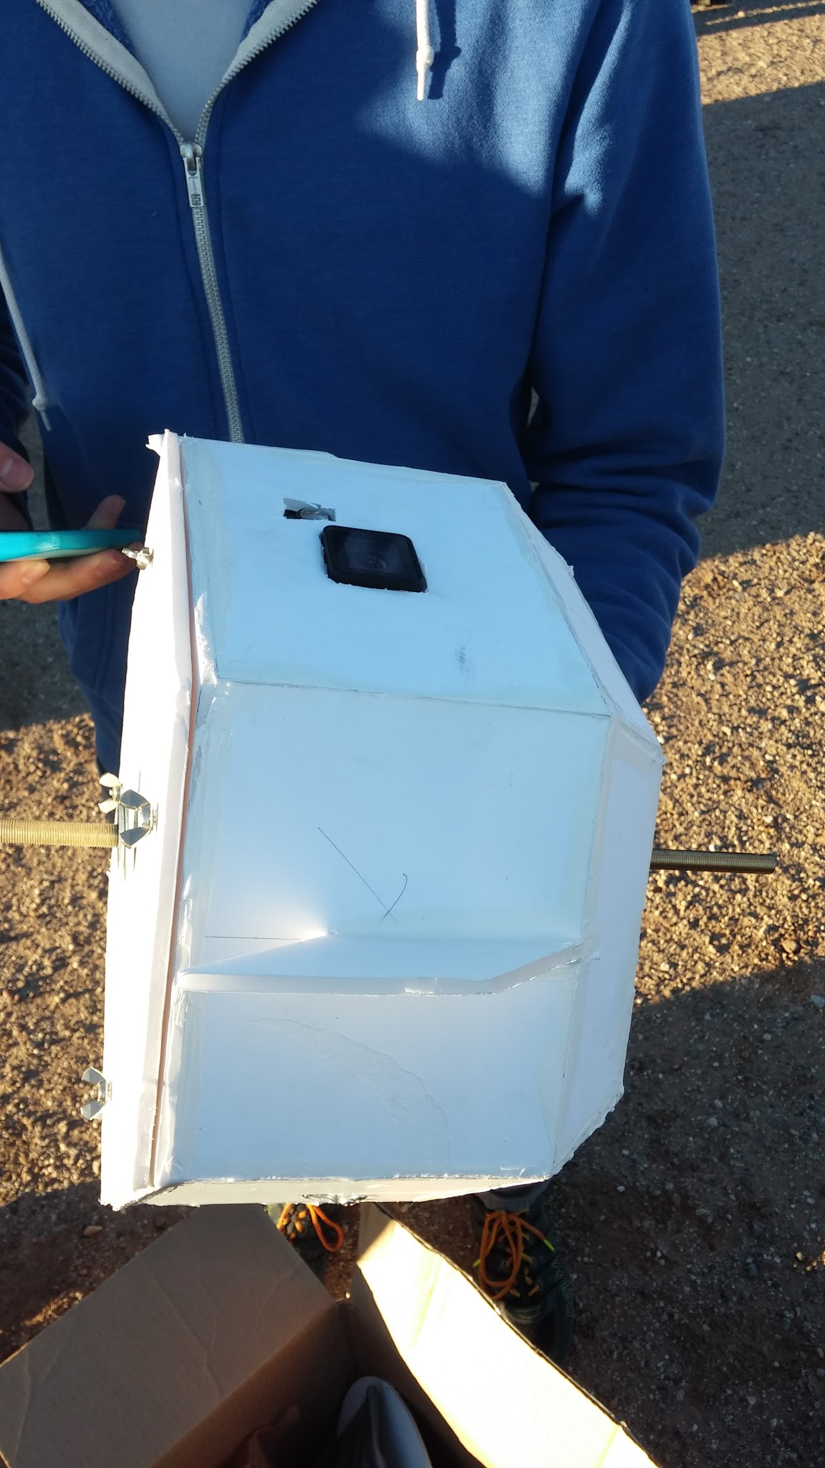
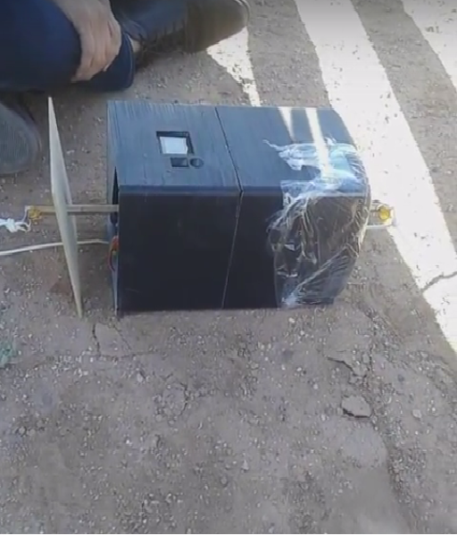
Goals
Build a system to collect particles from the atmosphere
Make a payload that is able to withstand the impact and cold temperatures
House electrical components and camera
Fall 2015
Spring 2016

Slide 3
Fall 2015

Slide 4
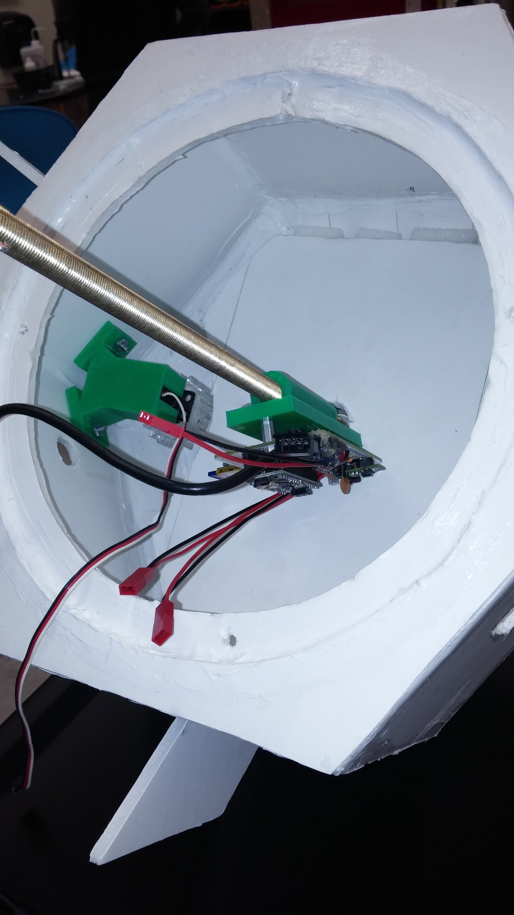
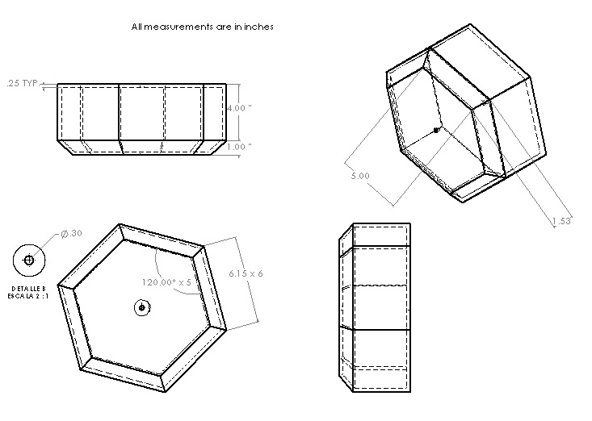
Payload Design
Servo motor glued to a small gear drives our larger gear
Hexagonal prism shape with 45° chamfers
Built from 3/16” foam board and glued together with silicone
Complete
CAD Payload Design

Slide 5
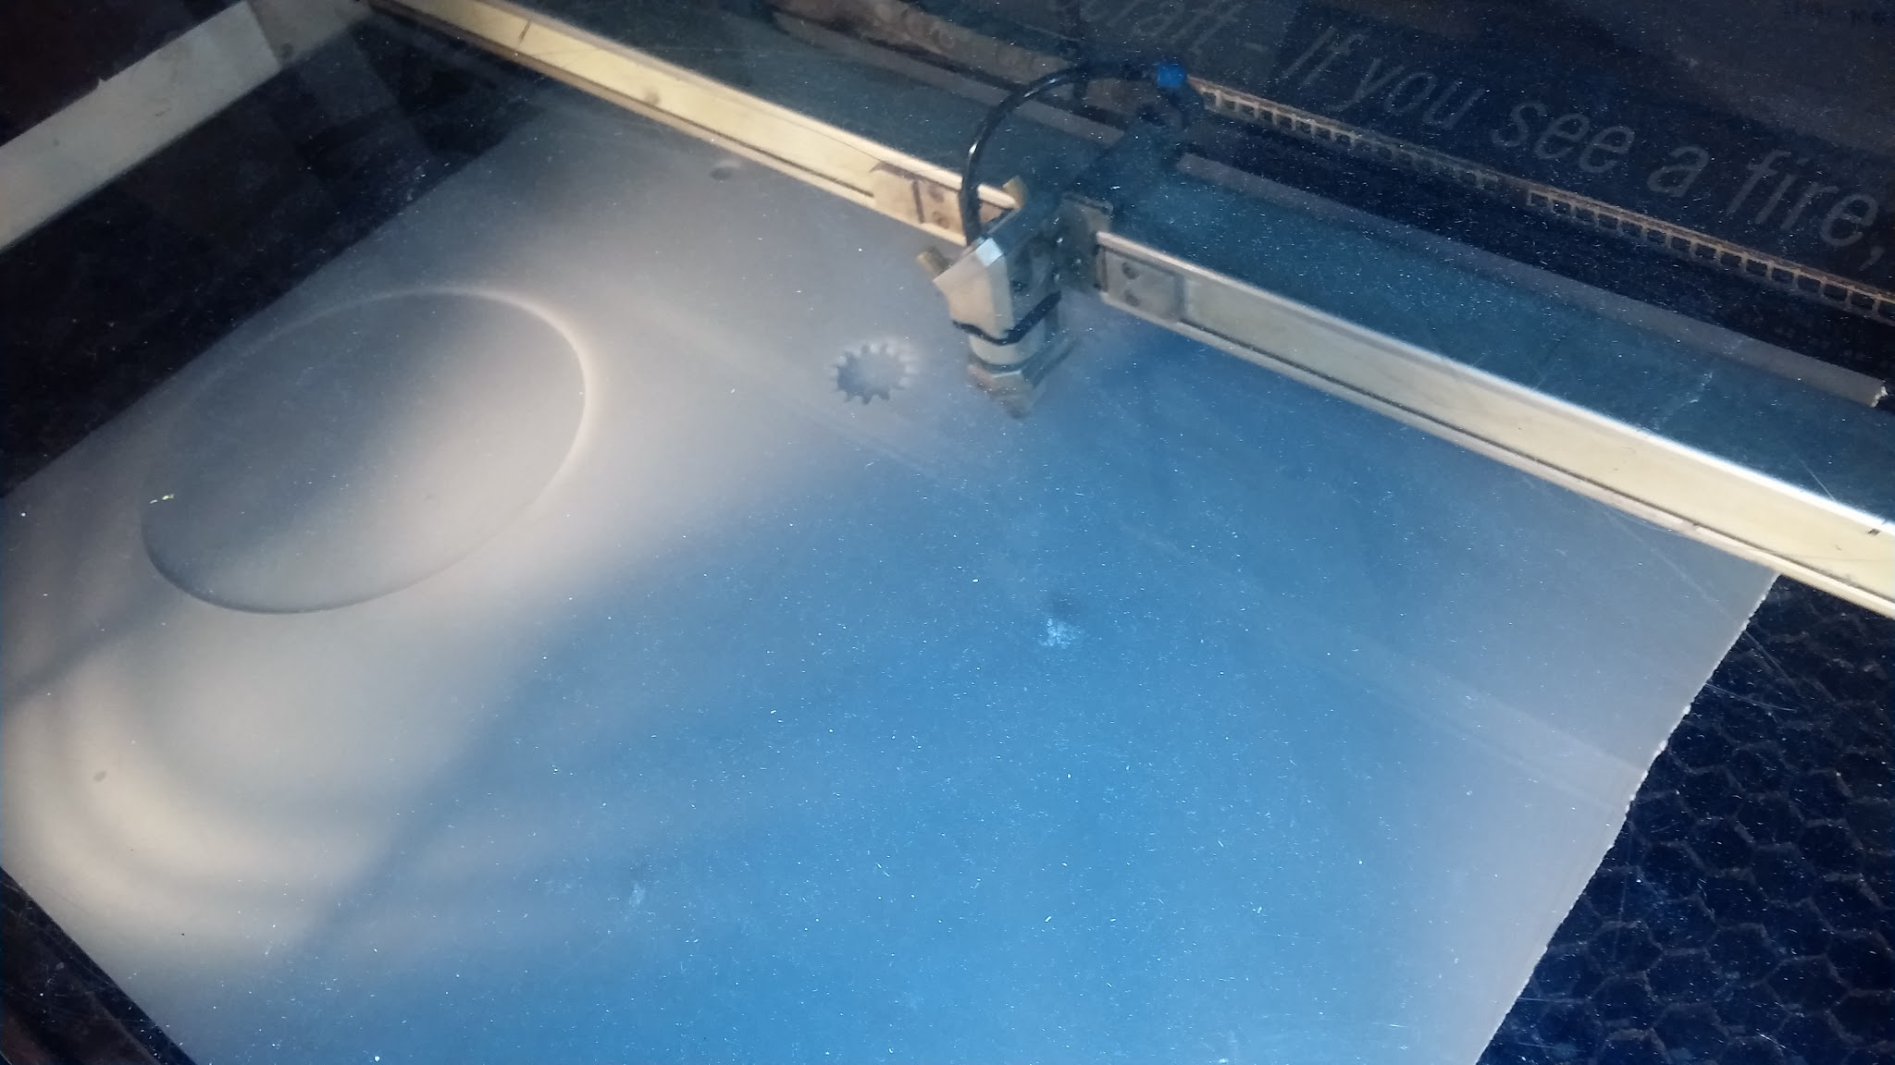
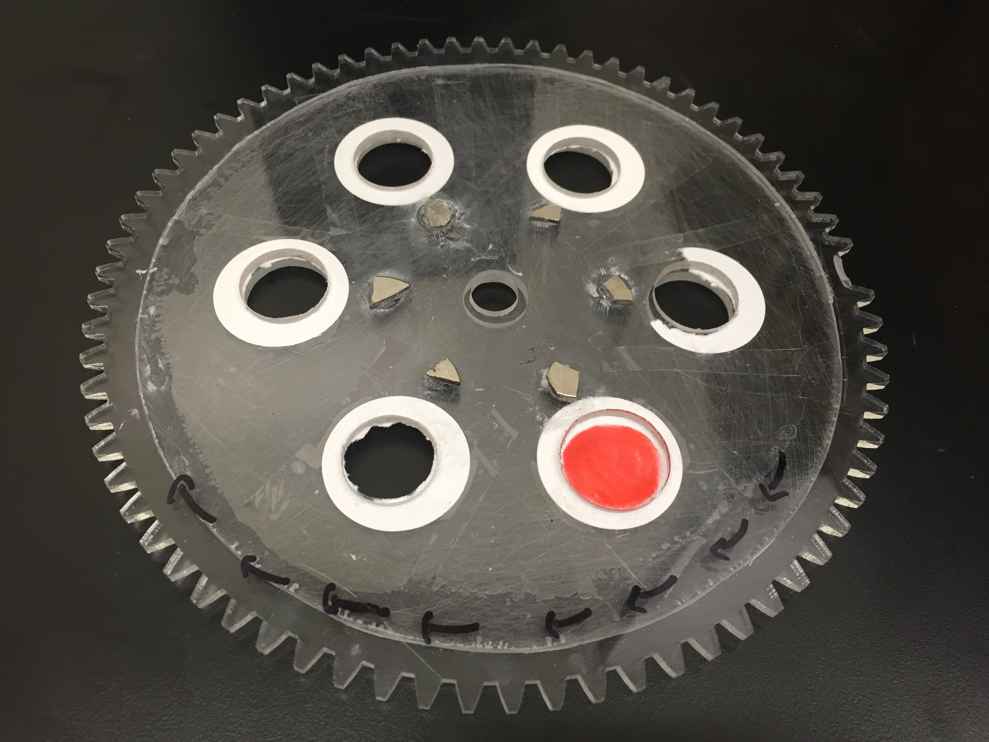
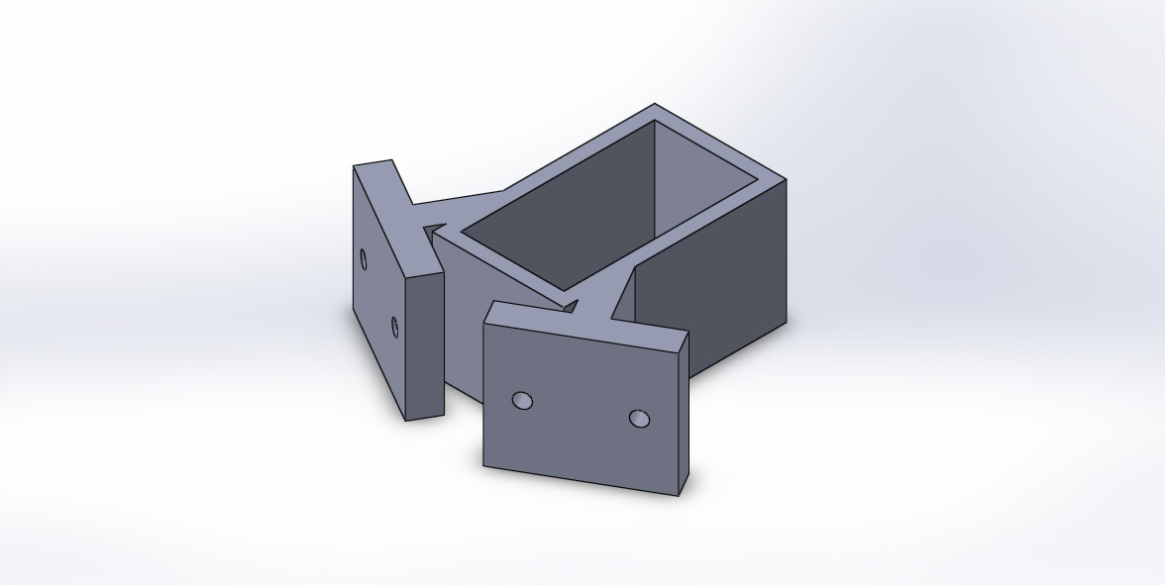
Particle Collection System
The foundation is a servo-driven system of two gears
Gears rotate every 20,000 feet of elevation
The holes are covered with type 1 qualitative filter paper
Servo mount 3-D printed and fixed to the side of the payload

Slide 6
Spring 2016

Slide 7
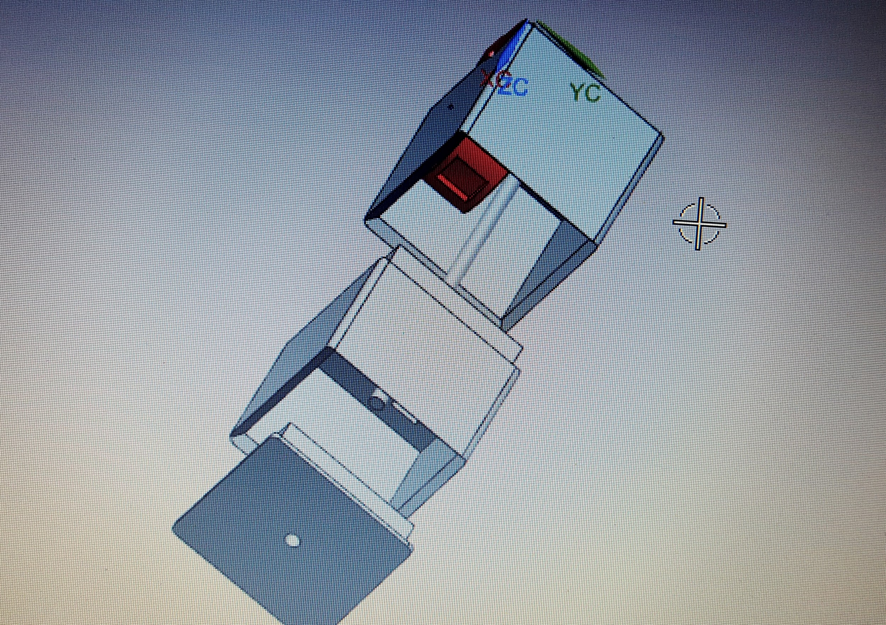
Stage 1: Design of Payload Body
Dimensioned to fit max print size on 3D Printer
Drawn on 3D CAD software (Solidworks)

Slide 8
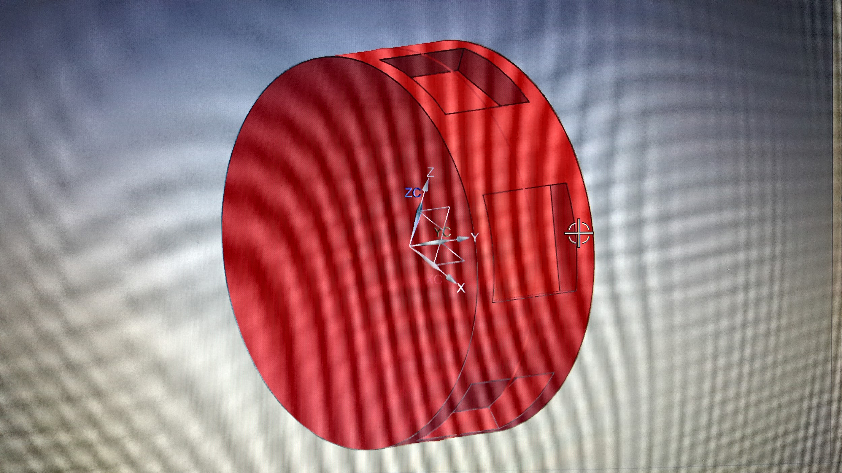
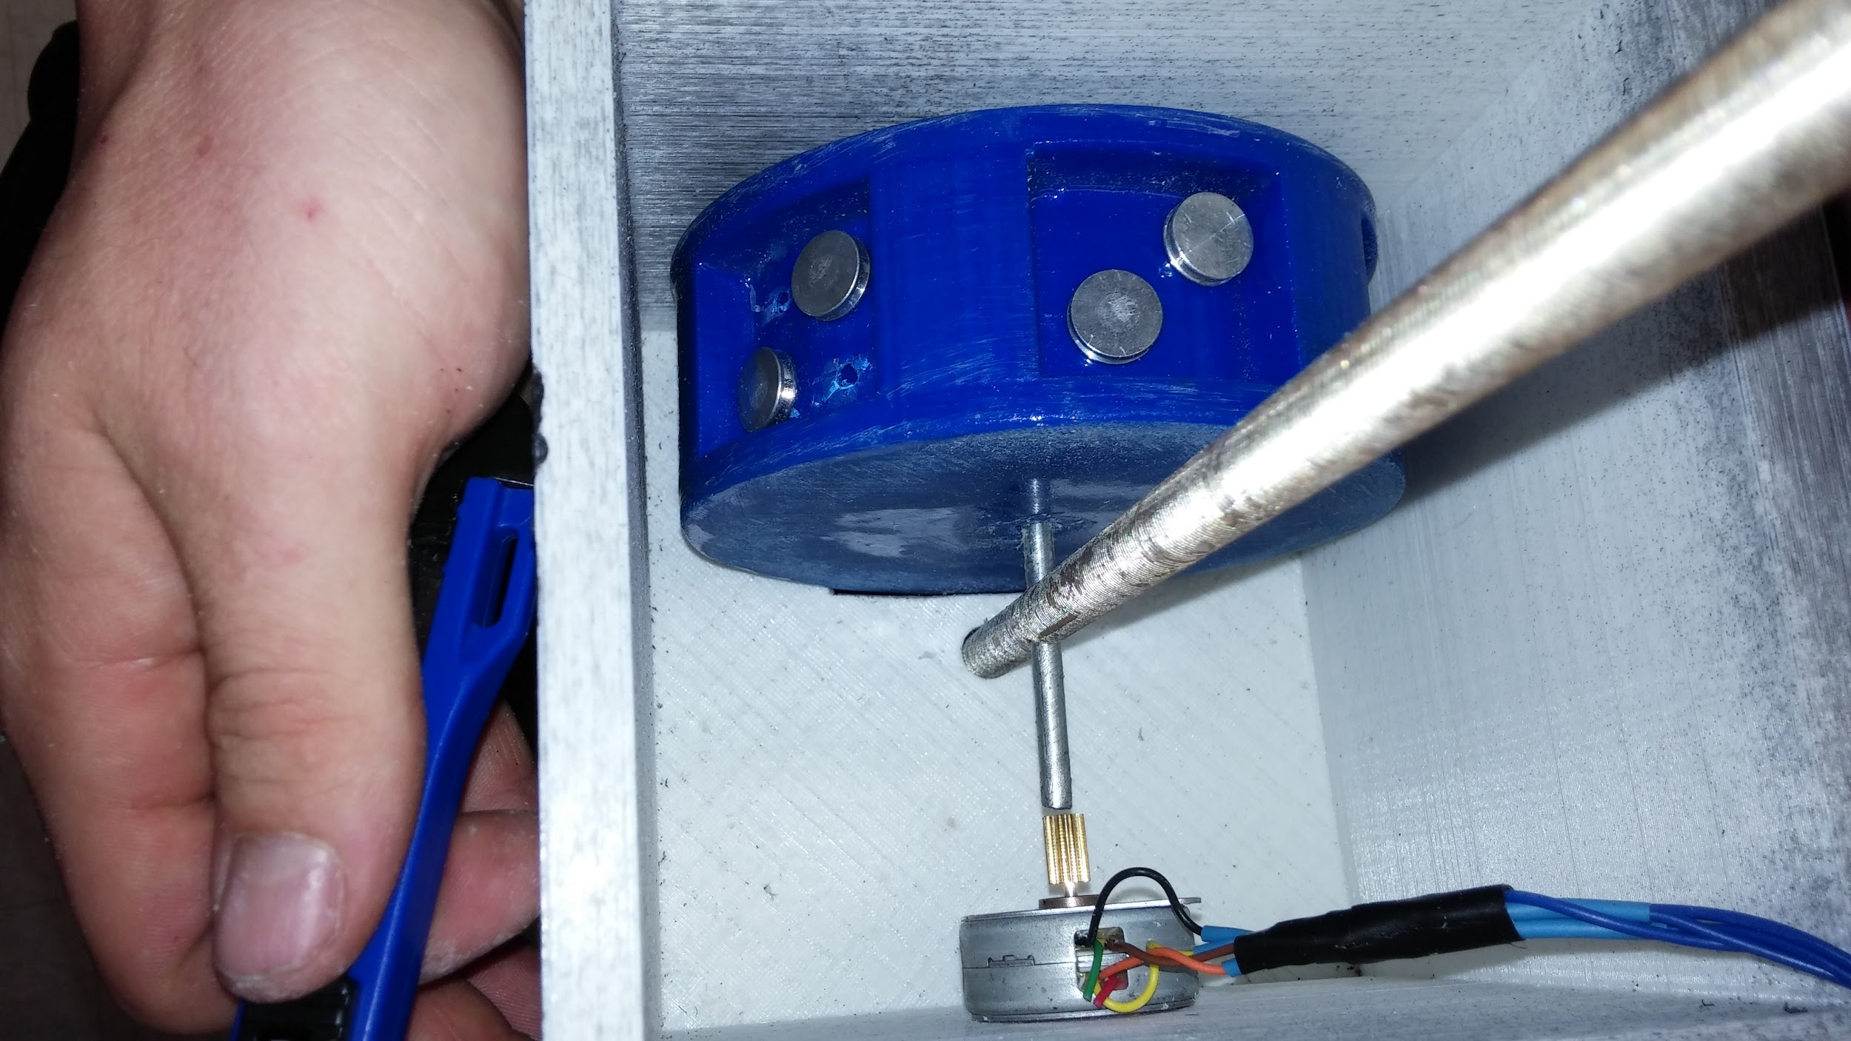
Stage 2: Design of Particle Collection System
“Ferris wheel” type object with seats to hold xerogel samples
Slot on the top of payload body
“Ferris wheel” rotates a certain amount at each altitude exposing samples to air for passive particle collection

Slide 9
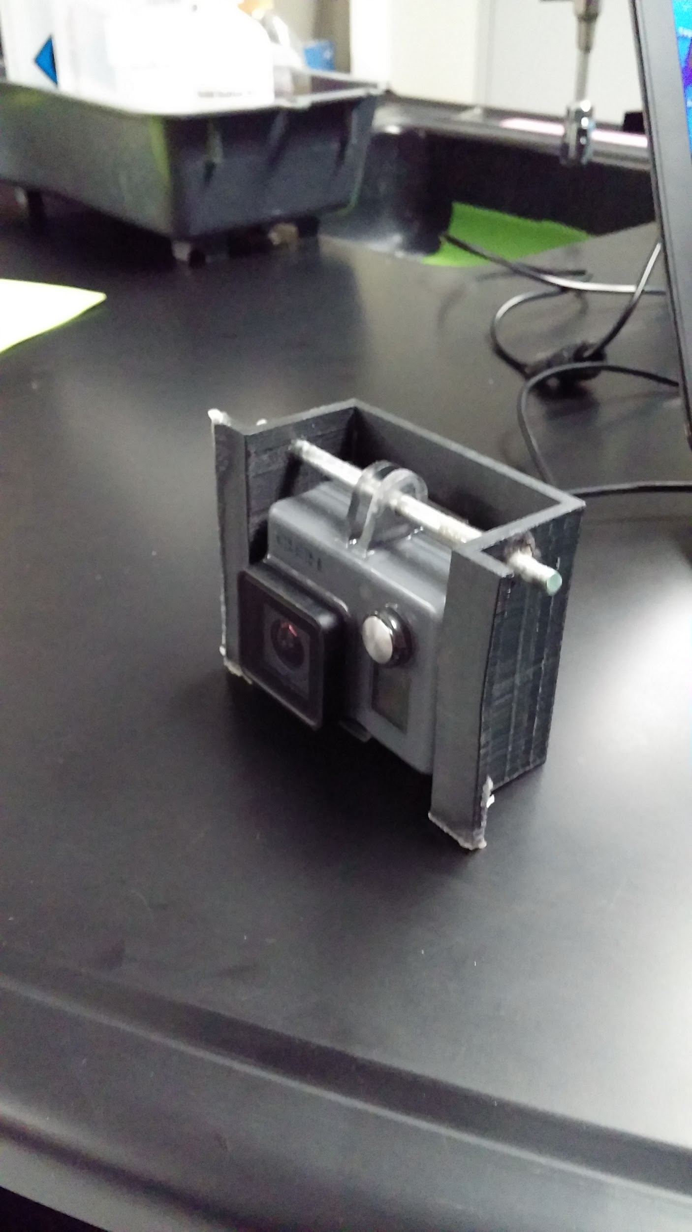
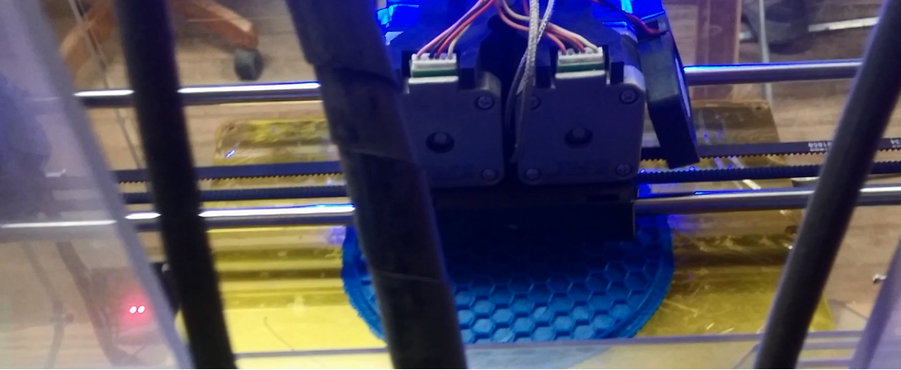
Stage 3: 3D Printing and Assembly
Carbon fiber ABS
Each chamber took about 25 hours to print
Go-Pro bracket also 3D printed and fitted

Slide 10
Results
Air getting through the slot for particle collection
Friction between particle collection apparatus and payload strained motor
Air penetrating payload body
Friction between
‘Ferris Wheel’ and
Payload wall

Slide 11
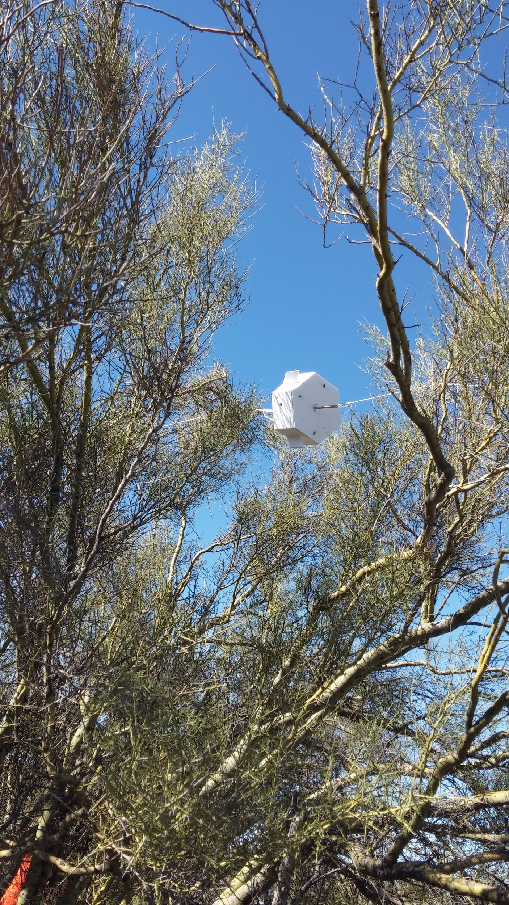
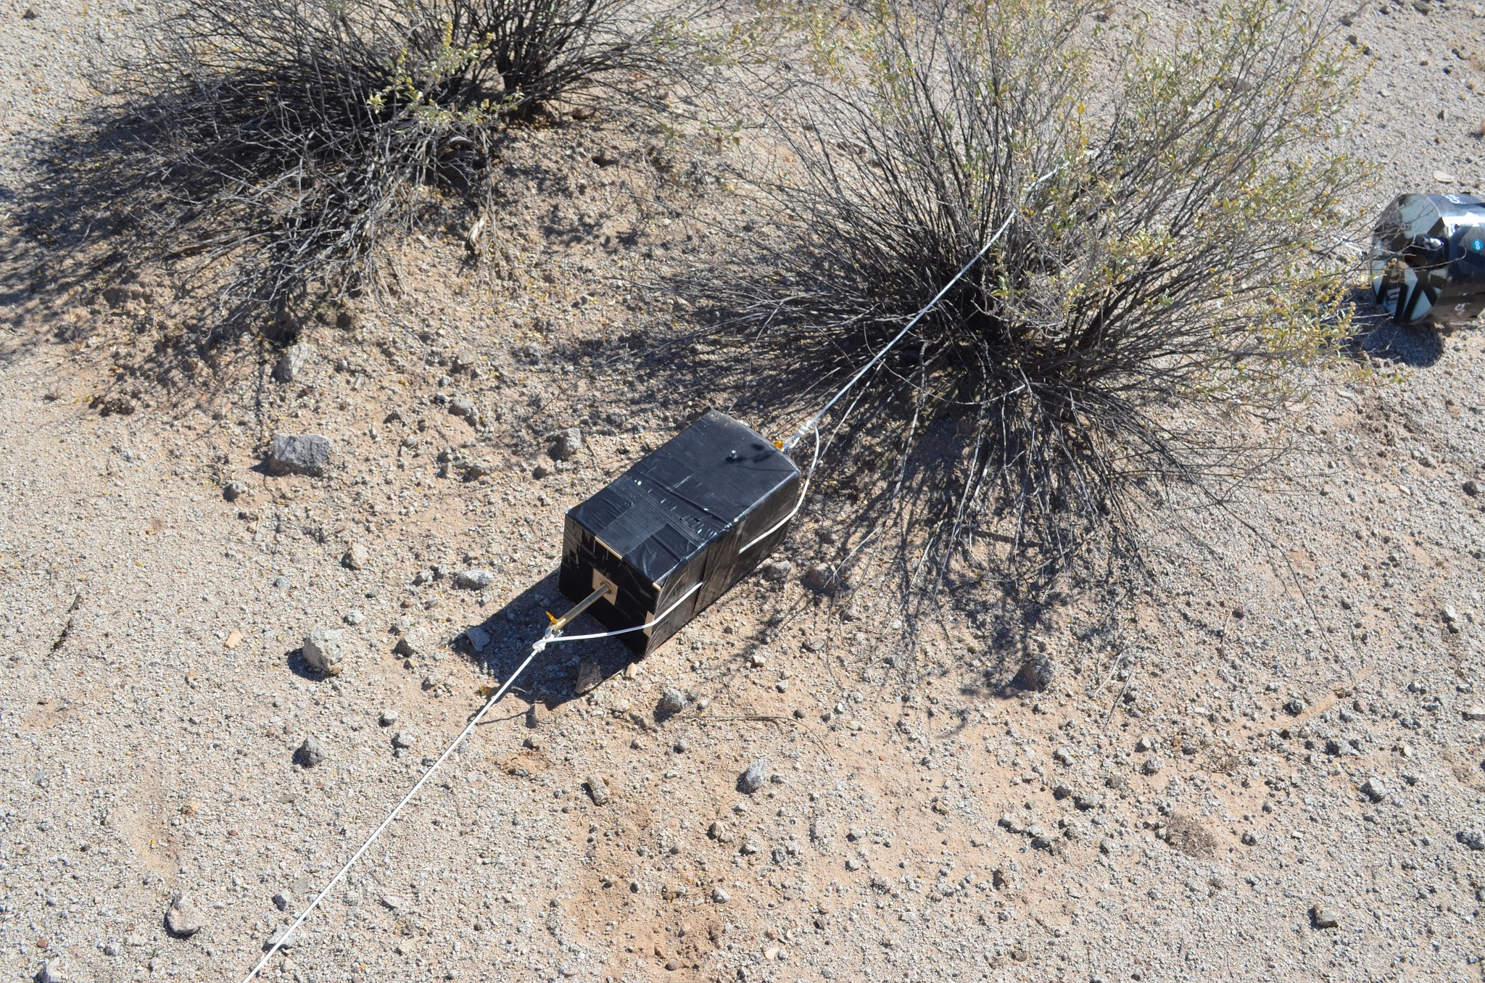
Conclusion
Both payloads withstood the impact with every component in tact
Both 3D printing and foam board are viable options for construction
The toughest challenge is the airtight to friction balance
Fall 2015
Payload
Landing
Spring 2016
Payload
Landing

Slide 12
Acknowledgements
Tim Swindle - Space Grant Director
Susan Brew - Space Grant Manager
Jack Crabtree and ANSR Staff
Silvia Kolchens - PCC West Mentor
Xerocraft Hackerspace
Questions?

